Slide 1
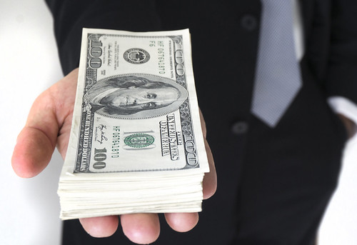

Predictive Modeling for Attorney Involvement in Claims
Group-05
Presentation by:
Ompreeth D R
ATHULYA Mohan V
JONNALAGADDA HARI BABU
Shoaib Akhtar Qureshi
Mr. veera sai krishna
Harish Abhishek Y
Anushka Dipak Khebade
This Photo by Unknown Author is licensed under CC BY

Slide 2

OUTLINE
We will cover these concepts:
Introduction
Project Objectives
Dataset Information
Exploratory Data Analysis (EDA)
Data Preprocessing & Visualizations
Train & Test Split
FEATURE ENGINEERING
Applying ML Algorithms
Model Evaluation
Best Model Selection
Output
Conclusion

Slide 3


Introduction
This project focuses on predicting whether an attorney will be involved in a claim based on claim-related factors. This capability aids insurance companies in optimizing processes, reducing legal costs, and allocating resources effectively.

Slide 4
PROJECT OBJECTIVES
Predict attorney involvement in claims using machine learning models.
Leverage claim-related data to enhance predictive accuracy.
Provide insights through feature engineering and model evaluation.
Deploy a user-friendly Streamlit application for predictions.

Slide 5
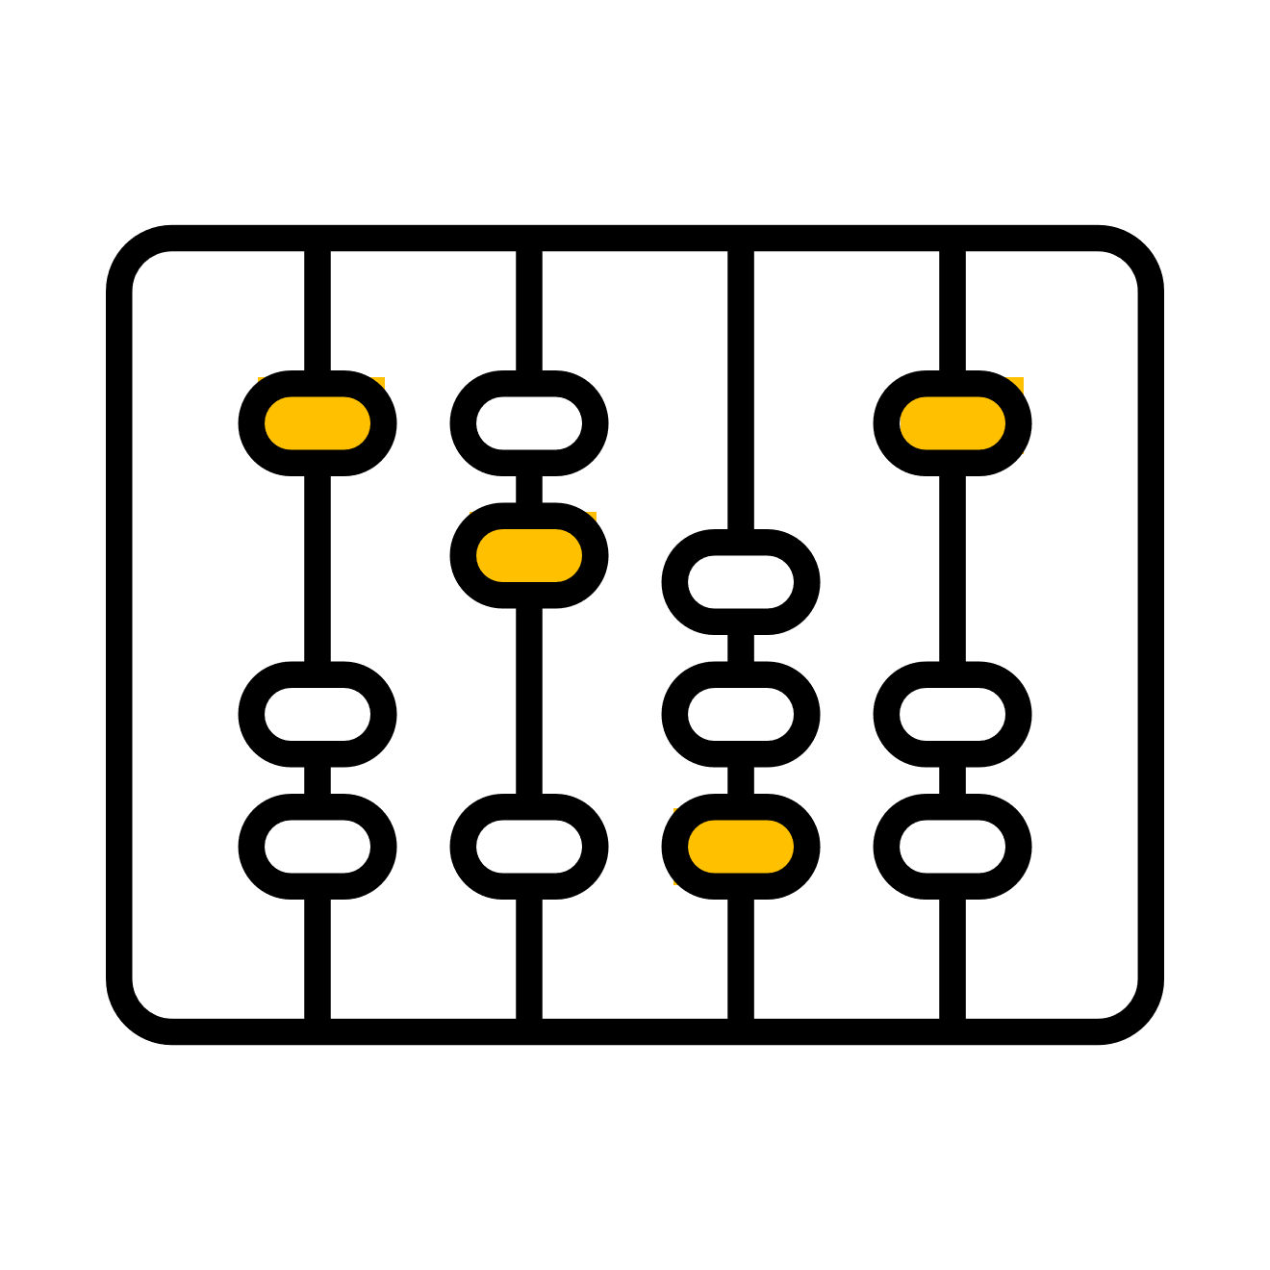

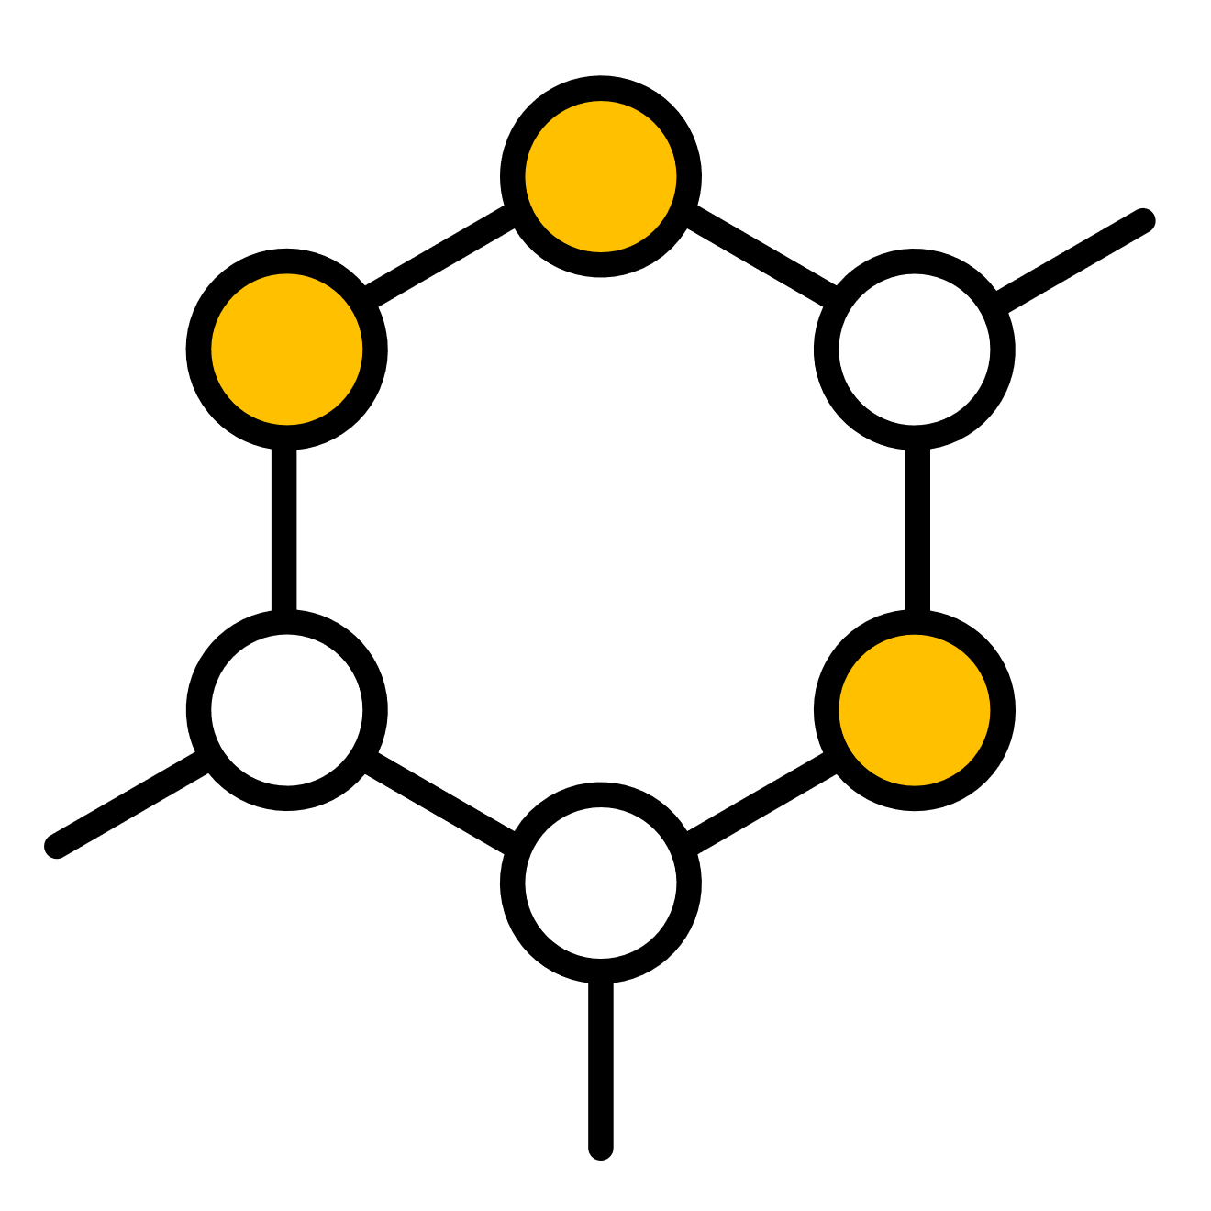
DATASET INFORMATION: Size: 1340 rows and 13 columns.
Key Features:
Key Features:
Key Features:
CASENUM: Unique identifier for each case.
ATTORNEY: Target variable (1: Yes, 0: No).
CLMSEX: Gender of the claimant (1: Male, 0: Female).
LOSS: Financial loss associated with the claim.
Accident_Severity: Severity of the accident (Minor, Moderate, Severe).
Driving_Record: Claimant's driving record.

Slide 6
EXPLORATORY DATA ANALYSIS (EDA)
Analysis :
Understand feature distributions (e.g., age, loss).
Identify correlations between features and the target.
Visualizations :
Heatmap for correlations.
Boxplots to visualize loss by accident severity.
Bar charts for categorical features like policy type and driving record.

Slide 7
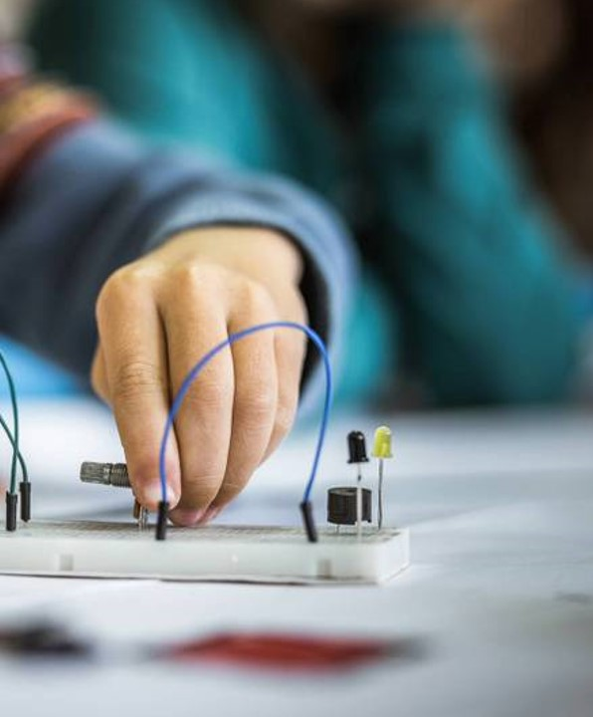
DATA PREPROCESSING & VISUALIZATIONS
Imputed missing values using appropriate strategies (mean for numerical, mode for categorical).
Encoded categorical variables (e.g., accident severity, driving record).
Visualized data distributions post-preprocessing to ensure balance and consistency.

Slide 8
TRAIN & TEST SPLIT
Splitting Strategy:
Train-test split: 70% training, 30% testing.
Ensured a balanced distribution of the target variable across splits.

Slide 9
FEATURE ENGINEERING (FE)
New features :
Settlement Ratio: Ratio of settlement amount to claim amount.
CLMINSUR_LOSS: Interaction between insured status and financial loss.
Seatbelt-Accident Severity Interaction: Encodes combined effect.
Rationale :
Rationale: Improved predictive power by deriving meaningful features.

Slide 10
APPLYING ML ALGORITHMS
Models used:
Logistic Regression
Random Forest
Support Vector Machines
Gradient Boosting
XGBoost

Slide 11
MODEL EVALUATION (ME)
Metrics :
Confusion matrices for each model.
Precision, recall, and F1-scores to measure classification performance.
Best performing models :
Logistic Regression: Best recall and F1-score.
Random Forest: Balanced performance across metrics.

Slide 12
BEST MODEL SELECTION
Final Choice:
Logistic Regression: Best recall and F1-score.
Logistic Regression for simplicity and interpretability.

Slide 13
OUTPUT
Streamlit App :
User inputs claim details in an intuitive interface.
Models predict attorney involvement in real-time.
Results displayed with actionable insights.
Deployment :
Models saved as “.pkl” files for integration.
App accessible via Streamlit and ngrok tunneling.

Slide 14
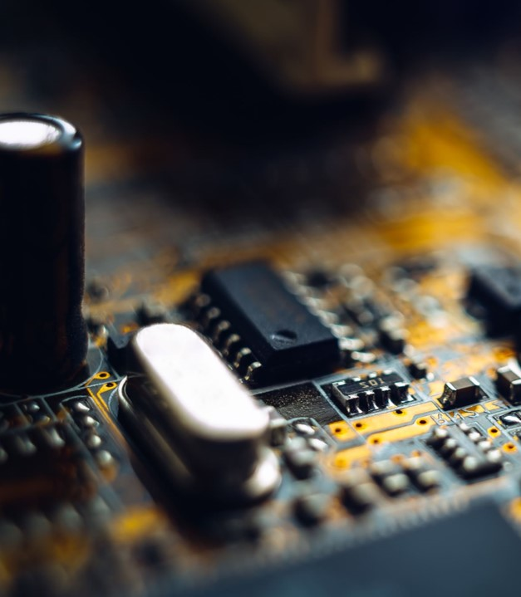
CONCLUSION
This project demonstrates effective use of data-driven approaches to predict attorney involvement in claims.
Benefits:
Cost reduction for insurers.
Data-driven decision-making.
Future Work:
Incorporate additional data for improved generalization.
Explore advanced techniques like deep learning for further enhancements.
Accessibility:
via Streamlit for real-time predictions.
Interacts with the system and generate predictions dynamically.

Slide 15

Thank you
Group-05
Ompreeth D R
ATHULYA Mohan V
JONNALAGADDA HARI BABU
Shoaib Akhtar Qureshi
Mr. veera sai krishna
Harish Abhishek Y
Anushka Dipak Khebade

